Slide 1
Announcements
Upcoming Deadlines:
Project 2 Phase 2 due March 5th.
Hope it’s been fun and not too stressful.
There’s a live lecture questions thread today.
Lab:
This week will be working on project 2 (free points).
Labs next will be project 2 demos.
We will ask you to provide a gradescope link to the submission you want to demo.
If submitted after the project 2 phase 2 deadline, we’ll deduct late points (but only from the demo part).

Slide 2
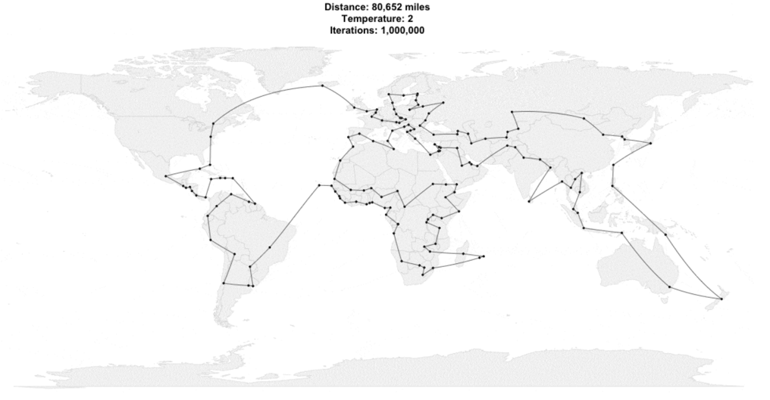
CS61B
Lecture 18: Asymptotics II: Analysis of Algorithms
Review of Asymptotic Notation
Examples 1-2: For Loops
Example 3: A Basic Recurrence
Example 4: Binary Search
Example 5: Mergesort

Slide 3
Example 1/2:For Loops

Slide 4
Loops Example 1: Based on Exact Count
Find the order of growth of the worst case runtime of dup1.
N = 6
int N = A.length;
for (int i = 0; i < N; i += 1)
for (int j = i + 1; j < N; j += 1)
if (A[i] == A[j])
return true;
return false;
0
1
2
3
4
5
 | == | == | == | == | ==
 |  | == | == | == | ==
 |  |  | == | == | ==
 |  |  |  | == | ==
 |  |  |  |  | ==
i
Worst case number of == operations:
C = 1 + 2 + 3 + … + (N - 3) + (N - 2) + (N - 1) = N(N-1)/2
0 1 2 3 4 5
j
operation | worst case count
== | Θ(N²)
Worst case runtime: Θ(N²)
Overall worst case runtime: Θ(N²)

Slide 5
Loops Example 1: Simpler Geometric Argument
Find the order of growth of the worst case runtime of dup1.
N = 6
int N = A.length;
for (int i = 0; i < N; i += 1)
for (int j = i + 1; j < N; j += 1)
if (A[i] == A[j])
return true;
return false;
0
1
2
3
4
5
 | == | == | == | == | ==
 |  | == | == | == | ==
 |  |  | == | == | ==
 |  |  |  | == | ==
 |  |  |  |  | ==
i
Worst case number of == operations:
Given by area of right triangle of side length N-1.
Area is Θ(N²).
0 1 2 3 4 5
j
operation | worst case count
== | Θ(N²)
Worst case runtime: Θ(N²)
Overall worst case runtime: Θ(N²)

Slide 6
Loops Example 2 [attempt #1]: http://yellkey.com/nature
Find a simple f(N) such that the runtime R(N) ∈ Θ(f(N)). By simple, we mean there should be no unnecessary multiplicative constants or additive terms.
1
log N
N
public static void printParty(int N) {
for (int i = 1; i <= N; i = i * 2) {
for (int j = 0; j < i; j += 1) {
System.out.println("hello");
int ZUG = 1 + 1;
}
}
}
D. N log N
E. N²
F. Other
Note that there’s only one case for this code and thus there’s no distinction between “worst case” and otherwise.
Notes:
est: 11 minutes to get here

Slide 7
Loops Example 2: Prelude to Attempt #2
0
1
2
3
4
5
public static void printParty(int N) {
for (int i = 1; i <= N; i = i * 2) {
for (int j = 0; j < i; j += 1) {
System.out.println("hello");
int ZUG = 1 + 1;
i
Find a simple f(N) such that the runtime R(N) ∈ Θ(f(N)).
0 1 2 3 4 5
j
Cost model C(N), println(“hello”) calls:
N
1 | 2 | 3 | 4 | 5 | 6 | 7 | 8 | 9 | 10 | 11 | 12 | 13 | 14 | 15 | 16 | 17 | 18
C(N)
? | ? | ? | ? | ? | ? | ? | ? | ? | ? | ? | ? | ? | ? | ? | ? | ? | ?
Notes:
2m30s, 23 total

Slide 8
Loops Example 2: Prelude to Attempt #2
0
1
2
3
4
5
public static void printParty(int N) {
for (int i = 1; i <= N; i = i * 2) {
for (int j = 0; j < i; j += 1) {
System.out.println("hello");
int ZUG = 1 + 1;
i
Find a simple f(N) such that the runtime R(N) ∈ Θ(f(N)).
0 1 2 3 4 5
j
Cost model C(N), println(“hello”) calls:
N
1 | 2 | 3 | 4 | 5 | 6 | 7 | 8 | 9 | 10 | 11 | 12 | 13 | 14 | 15 | 16 | 17 | 18
C(N)
1
Notes:
2m30s, 23 total

Slide 9
Loops Example 2: Prelude to Attempt #2
0
1
2
3
4
5
public static void printParty(int N) {
for (int i = 1; i <= N; i = i * 2) {
for (int j = 0; j < i; j += 1) {
System.out.println("hello");
int ZUG = 1 + 1;
i
Find a simple f(N) such that the runtime R(N) ∈ Θ(f(N)).
0 1 2 3 4 5
j
Cost model C(N), println(“hello”) calls:
N
1 | 2 | 3 | 4 | 5 | 6 | 7 | 8 | 9 | 10 | 11 | 12 | 13 | 14 | 15 | 16 | 17 | 18
C(N)
1 | 3
Notes:
2m30s, 23 total

Slide 10
Loops Example 2: Prelude to Attempt #2
0
1
2
3
4
5
public static void printParty(int N) {
for (int i = 1; i <= N; i = i * 2) {
for (int j = 0; j < i; j += 1) {
System.out.println("hello");
int ZUG = 1 + 1;
i
Find a simple f(N) such that the runtime R(N) ∈ Θ(f(N)).
0 1 2 3 4 5
j
Cost model C(N), println(“hello”) calls:
N
1 | 2 | 3 | 4 | 5 | 6 | 7 | 8 | 9 | 10 | 11 | 12 | 13 | 14 | 15 | 16 | 17 | 18
C(N)
1 | 3 | 3
N=2 and 3 both print 3 times
Notes:
2m30s, 23 total

Slide 11
Loops Example 2: Prelude to Attempt #2
0
1
2
3
4
5
public static void printParty(int N) {
for (int i = 1; i <= N; i = i * 2) {
for (int j = 0; j < i; j += 1) {
System.out.println("hello");
int ZUG = 1 + 1;
i
Find a simple f(N) such that the runtime R(N) ∈ Θ(f(N)).
0 1 2 3 4 5
j
Cost model C(N), println(“hello”) calls:
N
1 | 2 | 3 | 4 | 5 | 6 | 7 | 8 | 9 | 10 | 11 | 12 | 13 | 14 | 15 | 16 | 17 | 18
C(N)
1 | 3 | 3 | 7
Notes:
2m30s, 23 total

Slide 12
Loops Example 2: Prelude to Attempt #2
0
1
2
3
4
5
public static void printParty(int N) {
for (int i = 1; i <= N; i = i * 2) {
for (int j = 0; j < i; j += 1) {
System.out.println("hello");
int ZUG = 1 + 1;
i
Find a simple f(N) such that the runtime R(N) ∈ Θ(f(N)).
0 1 2 3 4 5
j
Cost model C(N), println(“hello”) calls:
N
1 | 2 | 3 | 4 | 5 | 6 | 7 | 8 | 9 | 10 | 11 | 12 | 13 | 14 | 15 | 16 | 17 | 18
C(N)
1 | 3 | 3 | 7 | 7 | 7 | 7
N=4,5,6,7 all print 7 times
Notes:
2m30s, 23 total

Slide 13
Loops Example 2: Prelude to Attempt #2
0
1
2
3
4
5
public static void printParty(int N) {
for (int i = 1; i <= N; i = i * 2) {
for (int j = 0; j < i; j += 1) {
System.out.println("hello");
int ZUG = 1 + 1;
i
Find a simple f(N) such that the runtime R(N) ∈ Θ(f(N)).
0 1 2 3 4 5
j
Cost model C(N), println(“hello”) calls:
N
1 | 2 | 3 | 4 | 5 | 6 | 7 | 8 | 9 | 10 | 11 | 12 | 13 | 14 | 15 | 16 | 17 | 18
C(N)
1 | 3 | 3 | 7 | 7 | 7 | 7 | 15 | 15 | 15 | 15 | 15 | 15 | 15 | 15
These N all print 15 times
Notes:
2m30s, 23 total

Slide 14
Loops Example 2: Prelude to Attempt #2
0
1
2
3
4
5
public static void printParty(int N) {
for (int i = 1; i <= N; i = i * 2) {
for (int j = 0; j < i; j += 1) {
System.out.println("hello");
int ZUG = 1 + 1;
i
Find a simple f(N) such that the runtime R(N) ∈ Θ(f(N)).
0 1 2 3 4 5
j
Cost model C(N), println(“hello”) calls:
N
1 | 2 | 3 | 4 | 5 | 6 | 7 | 8 | 9 | 10 | 11 | 12 | 13 | 14 | 15 | 16 | 17 | 18
C(N)
1 | 3 | 3 | 7 | 7 | 7 | 7 | 15 | 15 | 15 | 15 | 15 | 15 | 15 | 15 | 31 | 31 | 31
C(N) = 1 + 2 + 4 + … + N, if N is a power of 2
Notes:
2m30s, 23 total

Slide 15
Loops Example 2 [attempt #2]: http://yellkey.com/question
Find a simple f(N) such that the runtime R(N) ∈ Θ(f(N)).
1
log N
N
D. N log N
E. N²
F. Other
public static void printParty(int N) {
for (int i = 1; i<=N; i = i * 2) {
for (int j = 0; j < i; j += 1) {
System.out.println("hello");
int ZUG = 1 + 1;
Cost model C(N), println(“hello”) calls:
N
1 | 2 | 3 | 4 | 5 | 6 | 7 | 8 | 9 | 10 | 11 | 12 | 13 | 14 | 15 | 16 | 17 | 18
C(N)
1 | 3 | 3 | 7 | 7 | 7 | 7 | 15 | 15 | 15 | 15 | 15 | 15 | 15 | 15 | 31 | 31 | 31
C(N) = 1 + 2 + 4 + … + N, if N is a power of 2
Notes:
2m30s, 23 total

Slide 16
Loops Example 2: Prelude to Attempt #3
Find a simple f(N) such that the runtime R(N) ∈ Θ(f(N)).
N | C(N) | 0.5 N | 2N
1 | 1 | 0.5 | 2
4 | 1 + 2 + 4 = 7 | 2 | 14
7 | 1 + 2 + 4 = 7 | 3.5 | 14
8 | 1 + 2 + 4 + 8 = 15 | 4 | 16
27 | 1 + 2 + 4 + 8 + 16 = 31 | 13.5 | 54
185 | … + 64 + 128 = 255 | 92.5 | 370
715 | … + 256 + 512 = 1023 | 357.5 | 1430
Notes:
2m30s, 23 total

Slide 17
Loops Example 2 [attempt #3]: http://yellkey.com/article
Find a simple f(N) such that the runtime R(N) ∈ Θ(f(N)).
N | C(N)
1 | 1
4 | 1 + 2 + 4 = 7
7 | 1 + 2 + 4 = 7
8 | 1 + 2 + 4 + 8 = 15
27 | 1 + 2 + 4 + 8 + 16 = 31
185 | … + 64 + 128 = 255
715 | … + 256 + 512 = 1023
N | C(N) | 0.5 N | 2N
1 | 1 | 0.5 | 2
4 | 7 | 2 | 14
7 | 7 | 3.5 | 14
8 | 15 | 4 | 16
27 | 31 | 13.5 | 54
185 | 255 | 92.5 | 370
715 | 1023 | 357.5 | 1430
public static void printParty(int n) {
for (int i = 1; i<=n; i = i * 2) {
for (int j = 0; j < i; j += 1) {
System.out.println("hello");
int ZUG = 1 + 1;
Cost model C(N), println(“hello”) calls:
R(N) = Θ(1 + 2 + 4 + 8 + … + N) if N is power of 2.
1
log N
N
D. N log N
E. N²
F. Something else
Notes:
2m30s, 23 total

Slide 18
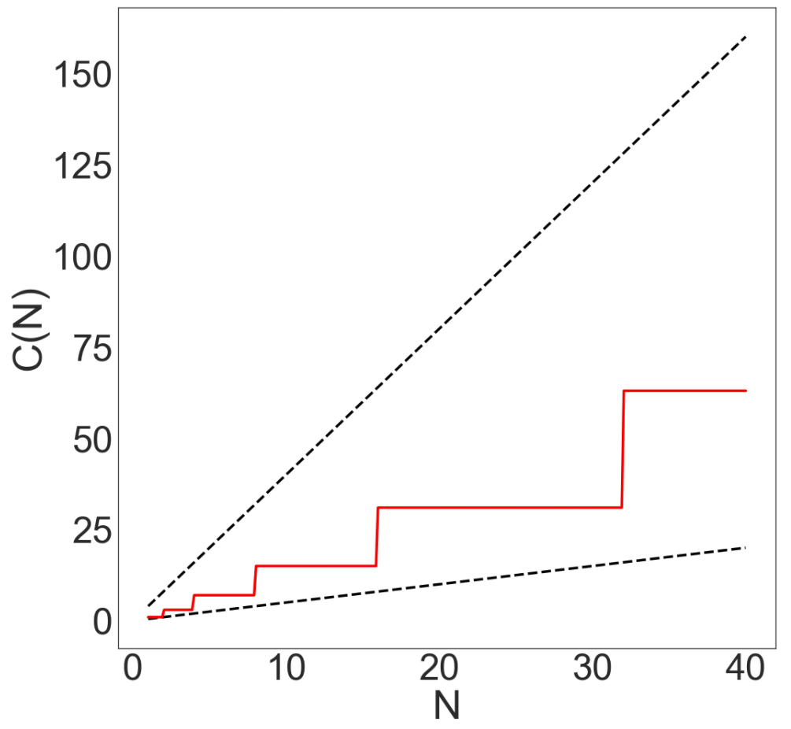
Loops Example 2 [attempt #3]: http://shoutkey.com/TBA
Find a simple f(N) such that the runtime R(N) ∈ Θ(f(N)).
R(N) = Θ(1 + 2 + 4 + 8 + … + N)
= Θ(N)
1
log N
N
D. N log N
E. N²
F. Something else
Can also compute exactly:
1 + 2 + 4 + … + N = 2N - 1
Ex: If N = 8
LHS: 1 + 2 + 4 + 8 = 15
RHS: 2*8 - 1 = 15
Notes:
2m30s, 23 total

Slide 19
Repeat After Me...
There is no magic shortcut for these problems (well… usually)
Runtime analysis often requires careful thought.
CS70 and especially CS170 will cover this in much more detail.
This is not a math class, though we’ll expect you to know these:
1 + 2 + 3 + … + Q = Q(Q+1)/2 = Θ(Q²)
1 + 2 + 4 + 8 + … + Q = 2Q - 1 = Θ(Q)
← Sum of First Natural Numbers (Link)
← Sum of First Powers of 2 (Link)
Where Q is a power of 2.
public static void printParty(int n) {
for (int i = 1; i <= n; i = i * 2) {
for (int j = 0; j < i; j += 1) {
System.out.println("hello");
int ZUG = 1 + 1;

Slide 20
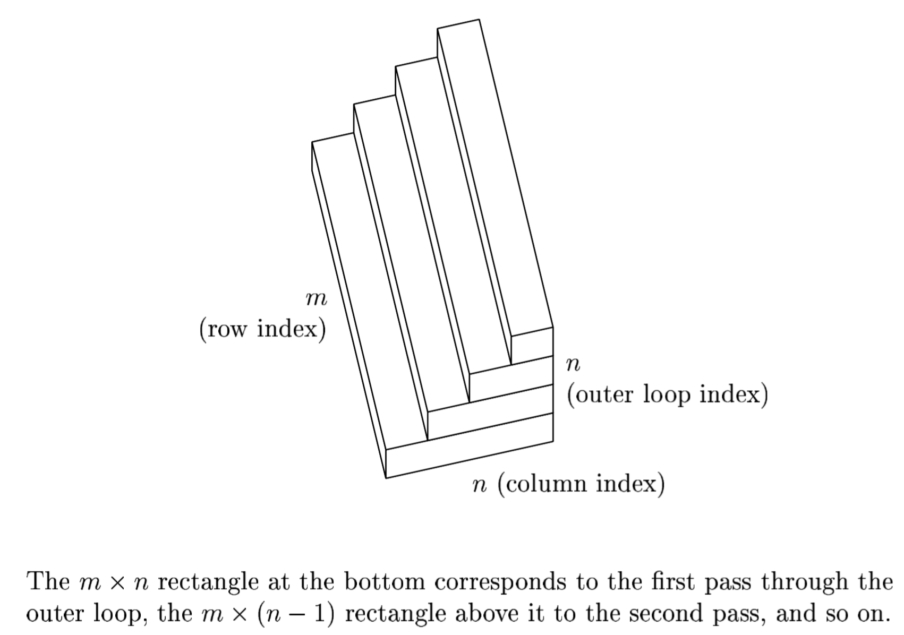
Repeat After Me...
There is no magic shortcut for these problems (well… usually)
Runtime analysis often requires careful thought.
CS70 and especially CS170 will cover this in much more detail.
This is not a math class, though we’ll expect you to know these:
1 + 2 + 3 + … + Q = Q(Q+1)/2 = Θ(Q²)
1 + 2 + 4 + 8 + … + Q = 2Q - 1 = Θ(Q)
Strategies:
Find exact sum.
Write out examples.
Draw pictures.
← Sum of First Natural Numbers (Link)
← Sum of First Powers of 2 (Link)
QR decomposition runtime, from “Numerical Linear Algebra” by Trefethen.

Slide 21
Example 3: Recursion

Slide 22
Recursion (Intuitive): http://yellkey.com/sound
Find a simple f(N) such that the runtime R(N) ∈ Θ(f(N)).
public static int f3(int n) {
if (n <= 1)
return 1;
return f3(n-1) + f3(n-1);
}
Using your intuition, give the order of growth of the runtime of this code as a function of N?
1
log N
N
N²
2^{N}
4
3
3
2
2
2
2
1
1
1
1
1
1
1
1

Slide 23
Recursion (Intuitive)
Find a simple f(N) such that the runtime R(N) ∈ Θ(f(N)).
public static int f3(int n) {
if (n <= 1)
return 1;
return f3(n-1) + f3(n-1);
}
2^{N}: Every time we increase N by 1, we double the work!
Using your intuition, give the order of growth of the runtime of this code as a function of N?
1
log N
N
N²
2^{N}
5
4
4
3
3
3
3
2
2
2
2
2
2
2
2
1
1
1
1
1
1
1
1
1
1
1
1
1
1
1
1

Slide 24
Recursion and Exact Counting
Find a simple f(N) such that the runtime R(N) ∈ Θ(f(N)).
public static int f3(int n) {
if (n <= 1)
return 1;
return f3(n-1) + f3(n-1);
}
Another approach: Count number of calls to f3, given by C(N).
C(1) = 1
C(2) = 1 + 2
C(3) = 1 + 2 + 4
4
3
3
2
2
2
2
1
1
1
1
1
1
1
1

Slide 25
Recursion and Exact Counting: http://yellkey.com/full
Find a simple f(N) such that the runtime R(N) ∈ Θ(f(N)).
public static int f3(int n) {
if (n <= 1)
return 1;
return f3(n-1) + f3(n-1);
}
Another approach: Count number of calls to f3, given by C(N).
C(3) = 1 + 2 + 4
C(N) = 1 + 2 + 4 + … + ???
What is the final term of the sum?
N
2^{N}
2^{N}-1
4
3
3
D. 2^{N-1}
E. 2^{N-1}-1
2
2
2
2
1
1
1
1
1
1
1
1

Slide 26
Recursion and Exact Counting
Find a simple f(N) such that the runtime R(N) ∈ Θ(f(N)).
public static int f3(int n) {
if (n <= 1)
return 1;
return f3(n-1) + f3(n-1);
}
Another approach: Count number of calls to f3, given by C(N).
C(3) = 1 + 2 + 4
C(N) = 1 + 2 + 4 + … + ???
What is the final term of the sum?
4
3
3
D. 2^{N-1}
2
2
2
2
1
1
1
1
1
1
1
1

Slide 27
Recursion and Exact Counting
Find a simple f(N) such that the runtime R(N) ∈ Θ(f(N)).
public static int f3(int n) {
if (n <= 1)
return 1;
return f3(n-1) + f3(n-1);
}
Another approach: Count number of calls to f3, given by C(N).
C(N) = 1 + 2 + 4 + … + 2^{N-1}
Give a simple expression for C(N).
4
3
3
2
2
2
2
1
1
1
1
1
1
1
1

Slide 28
Recursion and Exact Counting
Find a simple f(N) such that the runtime R(N) ∈ Θ(f(N)).
public static int f3(int n) {
if (n <= 1)
return 1;
return f3(n-1) + f3(n-1);
}
Another approach: Count number of calls to f3, given by C(N).
C(N) = 1 + 2 + 4 + … + 2^{N-1}
Give a simple expression for C(N).
C(N) = 2^{N} - 1
Why? It’s the Sum of First Powers of 2.
See next slide for details.
4
3
3
2
2
2
2
1
1
1
1
1
1
1
1

Slide 29
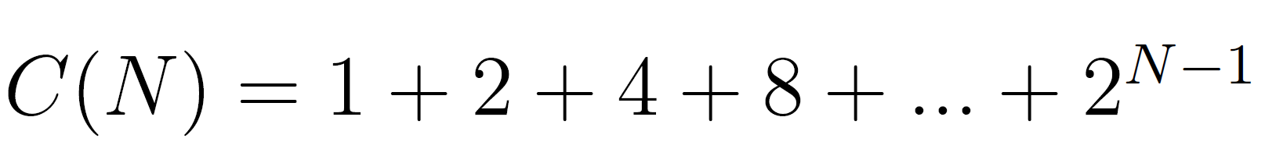
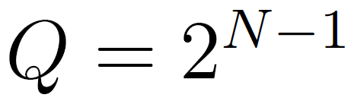
Recursion and Exact Counting, Solving for C(N)
We know that the Sum of the First Powers of 2 from before, i.e. as long as Q is a power of 2, then:
Thus, since , we have that:

Slide 30
Recursion and Exact Counting
Find a simple f(N) such that the runtime R(N) ∈ Θ(f(N)).
public static int f3(int n) {
if (n <= 1)
return 1;
return f3(n-1) + f3(n-1);
}
Another approach: Count number of calls to f3, given by C(N).
C(N) = 1 + 2 + 4 + … + 2^{N-1}
Solving, we get C(N) = 2^{N} - 1
Since work during each call is constant:
R(N) = Θ(2^{N})
4
3
3
2
2
2
2
1
1
1
1
1
1
1
1

Slide 31
Recursion and Recurrence Relations
Find a simple f(N) such that the runtime R(N) ∈ Θ(f(N)).
public static int f3(int n) {
if (n <= 1)
return 1;
return f3(n-1) + f3(n-1)
}
A third approach: Count number of calls to f3, given by a “recurrence relation” for C(N).
C(1) = 1
C(N) =
2C(N-1) + 1
4
3
3
2
2
2
2
1
1
1
1
1
1
1
1

Slide 32
Recursion and Recurrence Relations (Extra, Outside 61B Scope)
Find a simple f(N) such that the runtime R(N) ∈ Θ(f(N)).
public static int f3(int n) {
if (n <= 1)
return 1;
return f3(n-1) + f3(n-1)
}
A third approach: Count number of calls to f3, given by a “recurrence relation” for C(N).
C(1) = 1
C(N) =
2C(N-1) + 1
4
3
3
More technical to solve. Won’t do this in our course. See next slide for solution.
2
2
2
2
1
1
1
1
1
1
1
1

Slide 33
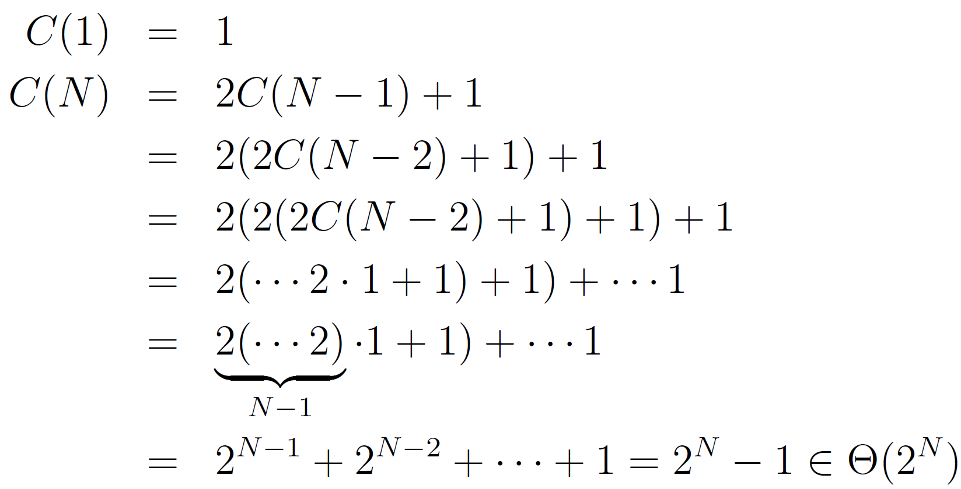
Recursion and Recurrence Relations (Extra, Outside 61B Scope)
Find a simple f(N) such that the runtime R(N) ∈ Θ(f(N)).
This approach not covered in class. Provided for those of you who want to see a recurrence relation solution.
public static int f3(int n) {
if (n <= 1)
return 1;
return f3(n-1) + f3(n-1)
}
One approach: Count number of calls to f3, given by C(N).
4
3
3
2
2
2
2
1
1
1
1
1
1
1
1

Slide 34
Example 4: Binary Search

Slide 35
Binary Search (demo: https://goo.gl/3VvJNw)
Trivial to implement?
Idea published in 1946.
First correct implementation in 1962.
Bug in Java’s binary search discovered in 2006.
See Jon Bentley’s book Programming Pearls.
See http://goo.gl/gQI0FN
static int binarySearch(String[] sorts, String x, int lo, int hi)
if (lo > hi) return -1;
int m = (lo + hi) / 2;
int cmp = x.compareTo(sorted[m]);
if (cmp < 0) return binarySearch(sorted, x, lo, m - 1);
else if (cmp > 0) return binarySearch(sorted, x, m + 1, hi);
else return m;
}
Notes:
http://www.cs.princeton.edu/courses/archive/fall14/cos226/demo/14DemoBinarySearch.pdf

Slide 36
Binary Search (Intuitive): http://yellkey.com/car
static int binarySearch(String[] sorts, String x, int lo, int hi)
if (lo > hi) return -1;
int m = (lo + hi) / 2;
int cmp = x.compareTo(sorted[m]);
if (cmp < 0) return binarySearch(sorted, x, lo, m - 1);
else if (cmp > 0) return binarySearch(sorted, x, m + 1, hi);
else return m;
}
Goal: Find runtime in terms of N = hi - lo + 1 [i.e. # of items being considered]
Intuitively, what is the order of growth of the worst case runtime?
1
log₂ N
N
N log₂ N
2^{N}
Notes:
http://www.cs.princeton.edu/courses/archive/fall14/cos226/demo/14DemoBinarySearch.pdf

Slide 37
Binary Search (Intuitive)
static int binarySearch(String[] sorts, String x, int lo, int hi)
if (lo > hi) return -1;
int m = (lo + hi) / 2;
int cmp = x.compareTo(sorted[m]);
if (cmp < 0) return binarySearch(sorted, x, lo, m - 1);
else if (cmp > 0) return binarySearch(sorted, x, m + 1, hi);
else return m;
}
Goal: Find runtime in terms of N = hi - lo + 1 [i.e. # of items being considered]
Intuitively, what is the order of growth of the worst case runtime?
B. log₂N
Why? Problem size halves over and over until it gets down to 1.
If C is number of calls to binarySearch, solve for 1 = N/2^{C} → C = log₂(N)
N
≈N/2
≈N/4
≈N/8
Notes:
http://www.cs.princeton.edu/courses/archive/fall14/cos226/demo/14DemoBinarySearch.pdf

Slide 38
Example 4: Binary Search Exact
(Optional) (see web video)

Slide 39
Binary Search (Exact Count): http://yellkey.com/allow
static int binarySearch(String[] sorts, String x, int lo, int hi)
if (lo > hi) return -1;
int m = (lo + hi) / 2;
int cmp = x.compareTo(sorted[m]);
if (cmp < 0) return binarySearch(sorted, x, lo, m - 1);
else if (cmp > 0) return binarySearch(sorted, x, m + 1, hi);
else return m;
}
Goal: Find worst case runtime in terms of N = hi - lo + 1 [i.e. # of items]
Cost model: Number of binarySearch calls.
What is C(6), number of total calls for N = 6?
6 D. 2
3 E. 1
log₂(6)=2.568
N=6
Notes:
http://www.cs.princeton.edu/courses/archive/fall14/cos226/demo/14DemoBinarySearch.pdf

Slide 40
Binary Search (Exact Count)
static int binarySearch(String[] sorts, String x, int lo, int hi)
if (lo > hi) return -1;
int m = (lo + hi) / 2;
int cmp = x.compareTo(sorted[m]);
if (cmp < 0) return binarySearch(sorted, x, lo, m - 1);
else if (cmp > 0) return binarySearch(sorted, x, m + 1, hi);
else return m;
}
Goal: Find worst case runtime in terms of N = hi - lo + 1 [i.e. # of items]
Cost model: Number of binarySearch calls.
What is C(6), number of total calls for N = 6?
B. 3
Three total calls, where N = 6, N = 3, and N = 1.
N=6
3 calls
N=3
N=1
Notes:
http://www.cs.princeton.edu/courses/archive/fall14/cos226/demo/14DemoBinarySearch.pdf

Slide 41
Binary Search (Exact Count)
static int binarySearch(String[] sorts, String x, int lo, int hi)
if (lo > hi) return -1;
int m = (lo + hi) / 2;
int cmp = x.compareTo(sorted[m]);
if (cmp < 0) return binarySearch(sorted, x, lo, m - 1);
else if (cmp > 0) return binarySearch(sorted, x, m + 1, hi);
else return m;
}
Goal: Find worst case runtime in terms of N = hi - lo + 1 [i.e. # of items]
Cost model: Number of binarySearch calls.
N
1 | 2 | 3 | 4 | 5 | 6 | 7 | 8 | 9 | 10 | 11 | 12 | 13
C(N)
1 |  |  |  |  | 3
N=1
Notes:
http://www.cs.princeton.edu/courses/archive/fall14/cos226/demo/14DemoBinarySearch.pdf

Slide 42
Binary Search (Exact Count)
static int binarySearch(String[] sorts, String x, int lo, int hi)
if (lo > hi) return -1;
int m = (lo + hi) / 2;
int cmp = x.compareTo(sorted[m]);
if (cmp < 0) return binarySearch(sorted, x, lo, m - 1);
else if (cmp > 0) return binarySearch(sorted, x, m + 1, hi);
else return m;
}
Goal: Find worst case runtime in terms of N = hi - lo + 1 [i.e. # of items]
Cost model: Number of binarySearch calls.
N
1 | 2 | 3 | 4 | 5 | 6 | 7 | 8 | 9 | 10 | 11 | 12 | 13
C(N)
1 | 2 | 2 |  |  | 3
N=2
N=3
N=1
Notes:
http://www.cs.princeton.edu/courses/archive/fall14/cos226/demo/14DemoBinarySearch.pdf

Slide 43
Binary Search (Exact Count)
static int binarySearch(String[] sorts, String x, int lo, int hi)
if (lo > hi) return -1;
int m = (lo + hi) / 2;
int cmp = x.compareTo(sorted[m]);
if (cmp < 0) return binarySearch(sorted, x, lo, m - 1);
else if (cmp > 0) return binarySearch(sorted, x, m + 1, hi);
else return m;
}
Goal: Find worst case runtime in terms of N = hi - lo + 1 [i.e. # of items]
Cost model: Number of binarySearch calls.
4
5
6
7
N
1 | 2 | 3 | 4 | 5 | 6 | 7 | 8 | 9 | 10 | 11 | 12 | 13
C(N)
1 | 2 | 2 | 3 | 3 | 3 | 3
N=2
N=3
N=1
Notes:
http://www.cs.princeton.edu/courses/archive/fall14/cos226/demo/14DemoBinarySearch.pdf

Slide 44
Binary Search (Exact Count)
static int binarySearch(String[] sorts, String x, int lo, int hi)
if (lo > hi) return -1;
int m = (lo + hi) / 2;
int cmp = x.compareTo(sorted[m]);
if (cmp < 0) return binarySearch(sorted, x, lo, m - 1);
else if (cmp > 0) return binarySearch(sorted, x, m + 1, hi);
else return m;
}
Goal: Find worst case runtime in terms of N = hi - lo + 1 [i.e. # of items]
Cost model: Number of binarySearch calls.
8
9
...
4
5
6
7
N
1 | 2 | 3 | 4 | 5 | 6 | 7 | 8 | 9 | 10 | 11 | 12 | 13
C(N)
1 | 2 | 2 | 3 | 3 | 3 | 3 | 4 | 4 | 4 | 4 | 4 | 4
N=2
N=3
N=1
Notes:
http://www.cs.princeton.edu/courses/archive/fall14/cos226/demo/14DemoBinarySearch.pdf

Slide 45
Binary Search (Exact Count)
static int binarySearch(String[] sorts, String x, int lo, int hi)
if (lo > hi) return -1;
int m = (lo + hi) / 2;
int cmp = x.compareTo(sorted[m]);
if (cmp < 0) return binarySearch(sorted, x, lo, m - 1);
else if (cmp > 0) return binarySearch(sorted, x, m + 1, hi);
else return m;
}
Goal: Find worst case runtime in terms of N = hi - lo + 1 [i.e. # of items]
Cost model: Number of binarySearch calls.
8
9
...
4
5
6
7
N
1 | 2 | 3 | 4 | 5 | 6 | 7 | 8 | 9 | 10 | 11 | 12 | 13
C(N)
1 | 2 | 2 | 3 | 3 | 3 | 3 | 4 | 4 | 4 | 4 | 4 | 4
N=2
N=3
C(N) = ⌊log₂(N)⌋+1
N=1
Notes:
http://www.cs.princeton.edu/courses/archive/fall14/cos226/demo/14DemoBinarySearch.pdf

Slide 46
Binary Search (Exact Count)
static int binarySearch(String[] sorts, String x, int lo, int hi)
if (lo > hi) return -1;
int m = (lo + hi) / 2;
int cmp = x.compareTo(sorted[m]);
if (cmp < 0) return binarySearch(sorted, x, lo, m - 1);
else if (cmp > 0) return binarySearch(sorted, x, m + 1, hi);
else return m;
}
Goal: Find worst case runtime in terms of N = hi - lo + 1 [i.e. # of items]
Cost model: Number of binarySearch calls.
C(N) = ⌊log₂(N)⌋+1
Since each call takes constant time, R(N) = Θ(⌊log₂(N)⌋)
This f(N) is way too complicated. Let’s simplify.
8
9
...
4
5
6
7
N=2
N=3
N=1
Notes:
http://www.cs.princeton.edu/courses/archive/fall14/cos226/demo/14DemoBinarySearch.pdf

Slide 47
Handy Big Theta Properties
Goal: Simplify Θ(⌊log₂(N)⌋)
Three handy properties to help us simplify:
⌊f(N)⌋=Θ(f(N)) [the floor of f has same order of growth as f]
⌈f(N)⌉=Θ(f(N)) [the ceiling of f has same order of growth as f]
log_{P}(N) = Θ(log_{Q}(N)) [logarithm base does not affect order of growth]
⌊log₂(N)⌋ = Θ(log N)
For proof:
See online textbook exercises.
Since base is irrelevant, we omit from our big theta expression. We also omit the parenthesis around N for aesthetic reasons.
Notes:
http://www.cs.princeton.edu/courses/archive/fall14/cos226/demo/14DemoBinarySearch.pdf

Slide 48
Binary Search (Exact Count)
static int binarySearch(String[] sorts, String x, int lo, int hi)
if (lo > hi) return -1;
int m = (lo + hi) / 2;
int cmp = x.compareTo(sorted[m]);
if (cmp < 0) return binarySearch(sorted, x, lo, m - 1);
else if (cmp > 0) return binarySearch(sorted, x, m + 1, hi);
else return m;
}
Goal: Find worst case runtime in terms of N = hi - lo + 1 [i.e. # of items]
Cost model: Number of binarySearch calls.
C(N) = ⌊log₂(N)⌋+1 = Θ(log N)
Since each call takes constant time, R(N) = Θ(log N)
… and we’re done!
8
9
...
4
5
6
7
N=2
N=3
N=1
Notes:
http://www.cs.princeton.edu/courses/archive/fall14/cos226/demo/14DemoBinarySearch.pdf

Slide 49
Binary Search (using Recurrence Relations)
static int binarySearch(String[] sorts, String x, int lo, int hi)
if (lo > hi) return -1;
int m = (lo + hi) / 2;
int cmp = x.compareTo(sorted[m]);
if (cmp < 0) return binarySearch(sorted, x, lo, m - 1);
else if (cmp > 0) return binarySearch(sorted, x, m + 1, hi);
else return m;
}
Approach: Measure number of string comparisons for N = hi - lo + 1.
C(0) = 0
C(1) = 1
C(N) = 1 + C((N-1)/2)
Can show that C(N) = Θ(log N). Beyond scope of class, so won’t solve in slides.
Notes:
http://www.cs.princeton.edu/courses/archive/fall14/cos226/demo/14DemoBinarySearch.pdf

Slide 50
Log Time Is Really Terribly Fast
In practice, logarithmic time algorithms have almost constant runtimes.
Even for incredibly huge datasets, practically equivalent to constant time.
N | log₂ N | Typical runtime (seconds)
100 | 6.6 | 1 nanosecond
100,000 | 16.6 | 2.5 nanoseconds
100,000,000 | 26.5 | 4 nanoseconds
100,000,000,000 | 36.5 | 5.5 nanoseconds
100,000,000,000,000 | 46.5 | 7 nanoseconds

Slide 51
Example 5: Mergesort

Slide 52
Selection Sort: A Prelude to Mergesort/Example 5
Earlier in class we discussed a sort called selection sort:
Find the smallest unfixed item, move it to the front, and ‘fix’ it.
Sort the remaining unfixed items using selection sort.
Runtime of selection sort is Θ(N²):
Look at all N unfixed items to find smallest.
Then look at N-1 remaining unfixed.
…
Look at last two unfixed items.
Done, sum is 2+3+4+5+...+N = Θ(N²)
SS
N=6
6
3
7
2
8
1
1
3
7
2
8
6
1
2
7
3
8
6
1
2
3
7
8
6
1
2
3
6
8
7
...

Slide 53
Selection Sort: A Prelude to Mergesort/Example 5
Earlier in class we discussed a sort called selection sort:
Find the smallest unfixed item, move it to the front, and ‘fix’ it.
Sort the remaining unfixed items using selection sort.
Runtime of selection sort is Θ(N²):
Look at all N unfixed items to find smallest.
Then look at N-1 remaining unfixed.
…
Look at last two unfixed items.
Done, sum is 2+3+4+5+...+N = Θ(N²)
Given that runtime is quadratic, for N = 64, we might say the runtime for selection sort is 2,048 arbitrary units of time (AU).
SS
~36 AU
N=6
SS
~2048 AU
N=64

Slide 54
The Merge Operation: Another Prelude to Mergesort/Example 5
Given two sorted arrays, the merge operation combines them into a single sorted array by successively copying the smallest item from the two arrays into a target array.
Merging Demo (Link)

Slide 55
Merge Runtime: http://yellkey.com/west
2
3
6
10
11
4
5
7
8
2
3
4
5
6
7
8
10
11
How does the runtime of merge grow with N, the total number of items?
Θ(1) C. Θ(N)
Θ(log N) D. Θ(N²)

Slide 56
Merge Runtime: http://shoutkey.com/TBA
2
3
6
10
11
4
5
7
8
2
3
4
5
6
7
8
10
11
How does the runtime of merge grow with N, the total number of items?
C. Θ(N). Why? Use array writes as cost model, merge does exactly N writes.

Slide 57
Using Merge to Speed Up the Sorting Process
Merging can give us an improvement over vanilla selection sort:
Selection sort the left half: Θ(N²).
Selection sort the right half: Θ(N²).
Merge the results: Θ(N).
SS
~2048 AU
N=64
N=64: ~1088 AU.
Merge: ~64 AU.
Selection sort: ~2*512 = ~1024 AU.
M
~64 AU
N=64
SS
SS
~512 AU
N=32
~512
N=32
Still Θ(N²), but faster since N+2*(N/2)² < N²
~1088 vs. ~2048 AU for N=64.

Slide 58
Two Merge Layers
Can do even better by adding a second layer of merges.
SS
~2048 AU
N=64
Runtime for each sort:
Selection sort only: ~2048 AU.
One layer of merges: ~1088 AU.
Two layers of merges: ~640 AU.
Merge: ~64 AU + 2*~32 AU.
Selection sort: 4*~128.
M
~64
N=64
M
M
~32
N=32
~32
N=32
SS
SS
SS
SS
~128
16
16
16
16

Slide 59
Example 5: Mergesort
Mergesort does merges all the way down (no selection sort):
If array is of size 1, return.
Mergesort the left half: Θ(??).
Mergesort the right half: Θ(??).
Merge the results: Θ(N).
SS
~2048 AU
N=64
M
Total runtime to merge all the way down: ~384 AU
Top layer: ~64 = 64 AU
Second layer: ~32*2 = 64 AU
Third layer: ~16*4 = 64 AU
Overall runtime in AU is ~64k, where k is the number of layers.
k = log₂(64) = 6, so ~384 total AU.
64
64
k
M
M
32
32
32
32
M
M
M
16
16
16
16
16
16
….
M
M
8
8
8
8
….
...

Slide 60
Example 5: Mergesort Order of Growth, yellkey.com/friend
For an array of size N, what is the worst case runtime of Mergesort?
Θ(1)
Θ(log N)
Θ(N)
Θ(N log N)
Θ(N²)
N
k
N/2
N/2
N/4
N/4
N/4
N/4
….
N/8
N/8
N/8
N/8
….

Slide 61
Example 5: Mergesort Order of Growth
Mergesort has worst case runtime = Θ(N log N).
Every level takes ~N AU.
Top level takes ~N AU.
Next level takes ~N/2 + ~N/2 = ~N.
One more level down: ~N/4 + ~N/4 + ~N/4 + ~N/4 = ~N.
Thus, total runtime is ~Nk, where k is the number of levels.
How many levels? Goes until we get to size 1.
k = log₂(N).
Overall runtime is Θ(N log N).
Exact count explanation is tedious.
Omitted here. See textbook exercises.
N
k
N/2
N/2
N/4
N/4
N/4
N/4
….
N/8
N/8
N/8
N/8
….

Slide 62
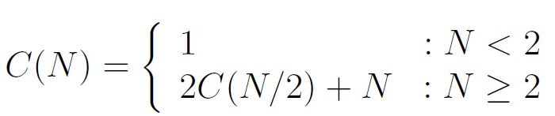
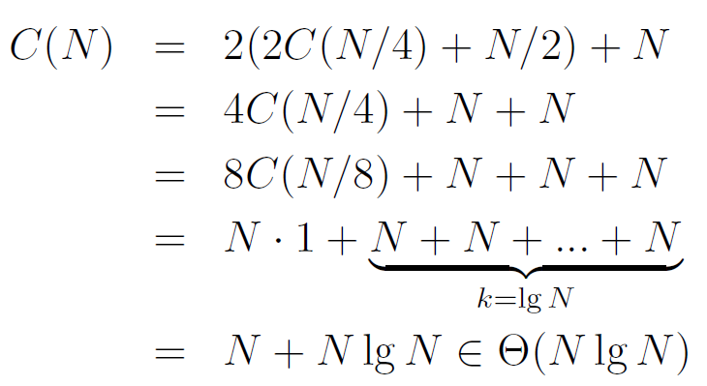
Mergesort using Recurrence Relations (Extra)
C(N): Number of calls to mergesort + number of array writes.
Only works for N=2^{k}. Can be generalized at the expense of some tedium by separately finding Big O and Big Omega bounds (see next lecture).
N
k
N/2
N/2
N/4
N/4
N/4
N/4
….
N/8
N/8
N/8
N/8
….

Slide 63
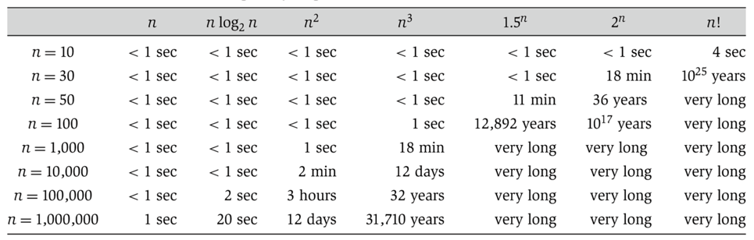

Linear vs. Linearithmic (N log N) vs. Quadratic
N log N is basically as good as N, and is vastly better than N².
For N = 1,000,000, the log N is only 20.
(from Algorithm Design: Tardos, Kleinberg)

Slide 64
Summary
Theoretical analysis of algorithm performance requires careful thought.
There are no magic shortcuts for analyzing code.
In our course, it’s OK to do exact counting or intuitive analysis.
Know how to sum 1 + 2 + 3 … + N and 1 + 2 + 4 + … + N.
We won’t be writing mathematical proofs in this class.
Many runtime problems you’ll do in this class resemble one of the five problems from today. See textbook, study guide, and discussion for more practice.
This topic has one of the highest skill ceilings of all topics in the course.
Different solutions to the same problem, e.g. sorting, may have different runtimes.
N² vs. N log N is an enormous difference.
Going from N log N to N is nice, but not a radical change.

